Slide 1
CGT 620 Lab 5
Yuanpei Zhao

Slide 2
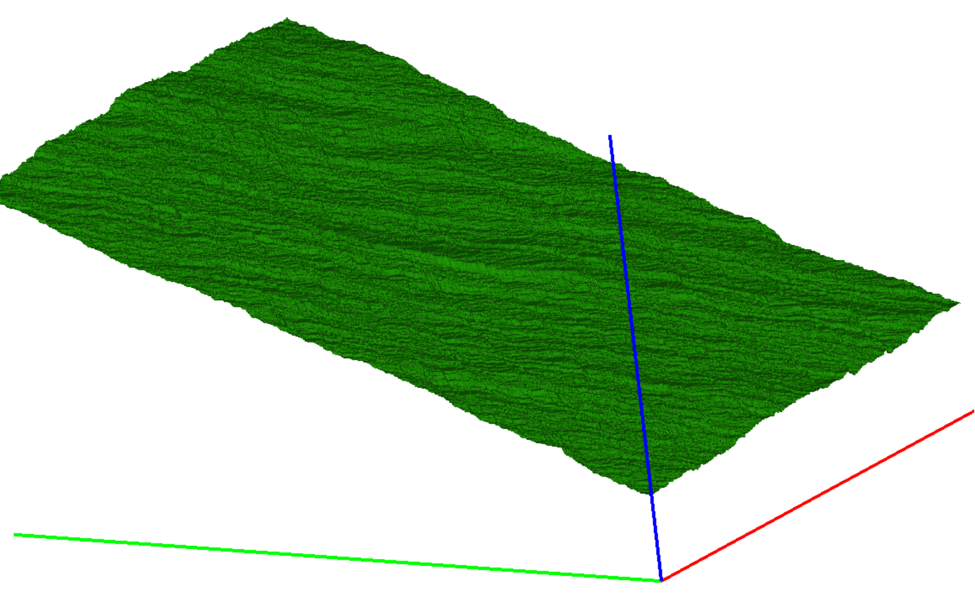
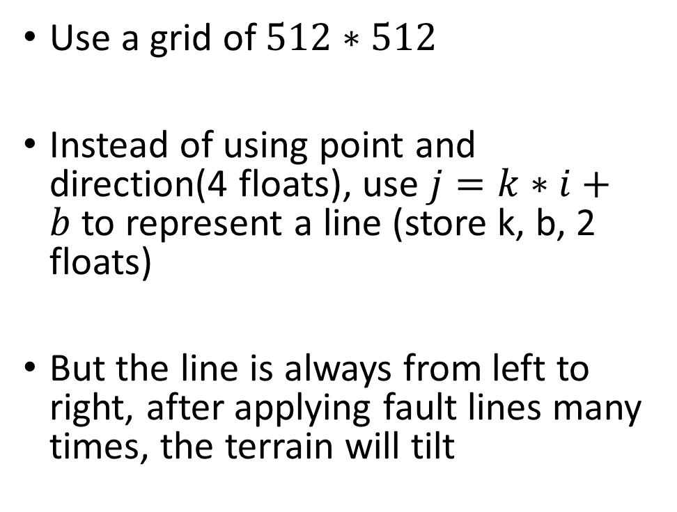
CPU implementation
Use a grid of $512∗512$
Instead of using point and direction(4 floats), use $j=k∗i+b$to represent a line (store k, b, 2 floats)
But the line is always from left to right, after applying fault lines many times, the terrain will tilt

Slide 3
CPU implementation
Solution: add a random variable r = 1 or -1 for each line
The terrain will choose random side of line to increase or decrease
Total 3 floats, still less than 4 floats

Slide 4
GPU implementation
Define the line data as constant memory
Parallel compute each i, j
For each line:
Check i > j *k+b, if so, a[i][j] += r*elevation
Else, a[i][j] -= r*elevation

Slide 5
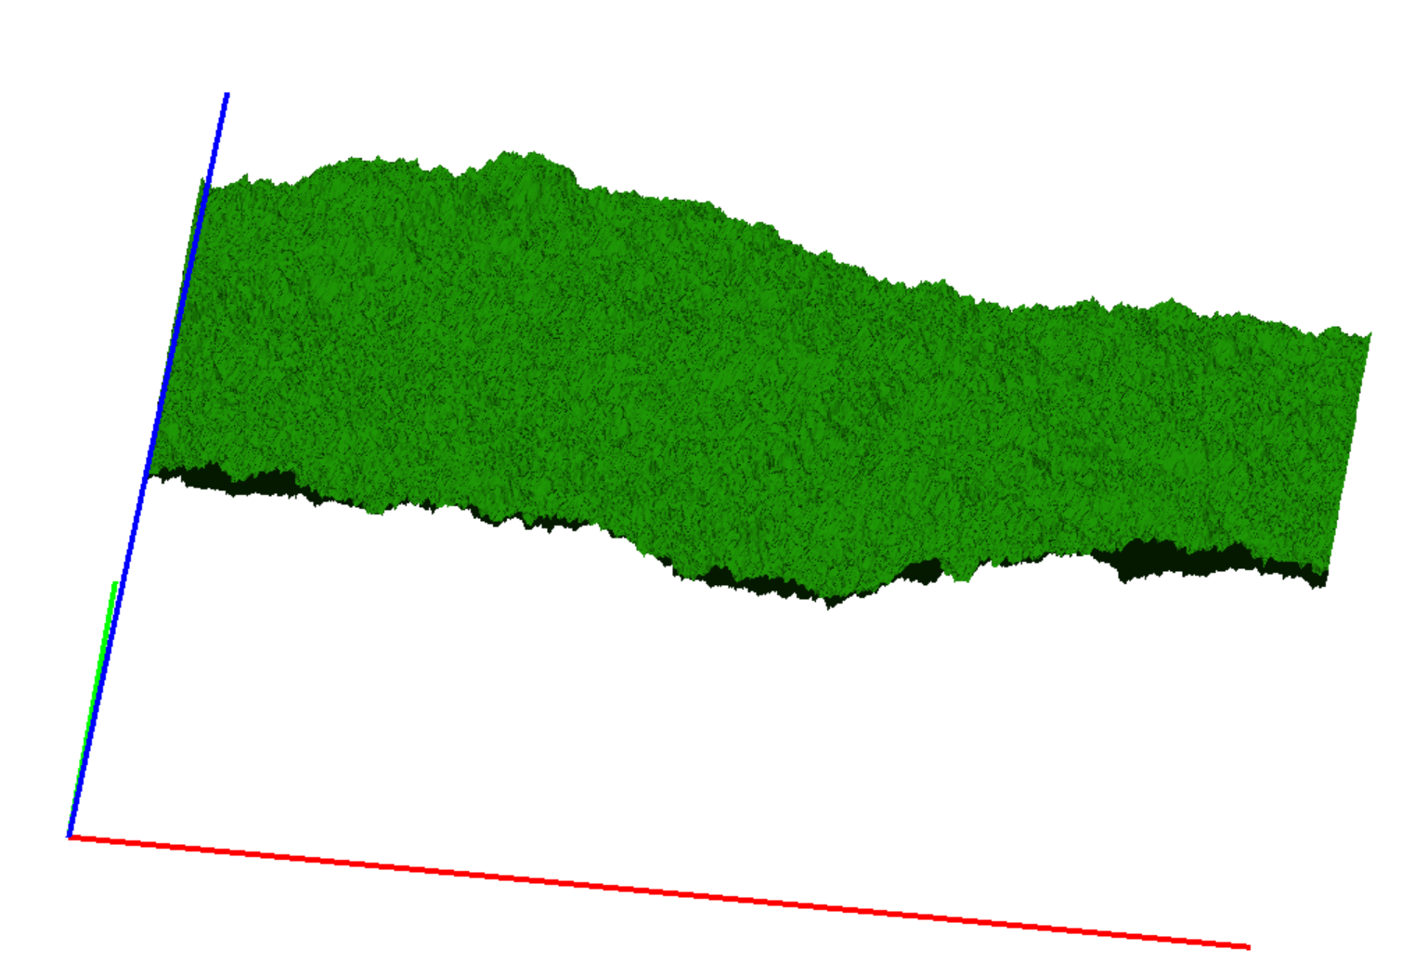
Result

Slide 6
Result
n | 1 | 2 | 4 | 8 | 16 | 32 | 64 | 128 | 256 | 512 | 1024 | 2048 | 4096
CPU | 1 | 3 | 5 | 11 | 22 | 44 | 86 | 173 | 344 | 688 | 1373 | 2761 | 5481
GPU | 0.69 | 0.71 | 0.75 | 0.78 | 0.95 | 1.25 | 1.49 | 2.21 | 3.8 | 6.84 | 13.08 | 25.61 | 50.68

